Slide 1
Natural language processing
Lecture 2: Count-based models and vector spaces
Roberta Rocca
Assistant Professor, IMC & CHC
✉️ roberta.rocca@cas.au.dk
Notes:
The LSA / SVD paper
Glove paper
Baroni paper
Mikolov paper

Slide 2
today’s plan
Resuming where we left off: how do we represent word meaning?
The distributional hypothesis
Count-based (or bag-of-words) models
Normalizing and compressing representations
Vector spaces
Evaluating word vectors

Slide 3
where were we at?
Earlier approaches to NLP focused on defining meaning using manually crafted knowledge bases and combinatorial rules
Since the 90s statistical approaches become popular: all you need to build a useful representation of the fundamental units of text is … (enough) text.
But how do we go about doing defining meaning representations in a bottom-up way? We have seen that basic approaches (e.g., one-hot encodings) don’t work
Notes:
Bootstrapped by information retrieval

Slide 4
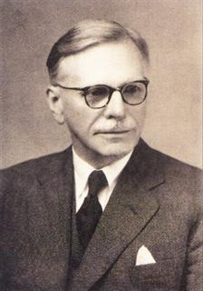
The distributional hypothesis
“You shall know a word by the company it keeps”
J.R. Firth, 1957
Studies in Linguistic Analysis
Notes:
Against referential semantics!

Slide 5
The distributional hypothesis
The assumption is that contexts characteristics are good proxies of the meaning of a word (distributional semantic models, or DSMs)
You can build a representation of what a word means by looking at the set of contexts it tends to occur in
Words with similar meanings will tend to occur in similar contexts
“I'm trying to clear my mind of all this”
“There was no doubt in his mind that the man was serious”
“Studying stretched my mind and got me thinking about things”
Notes:
Rather than reference to an external object that computers have no access to… very conveniently, text is something you have access to. Look at examples

Slide 6
The distributional hypothesis
The assumption is that contexts characteristics are good proxies of the meaning of a word (distributional semantic models, or DSMs)
You can build a representation of what a word means by looking at the set of contexts it tends to occur in
Words with similar meanings will tend to occur in similar contexts (e.g., you could swap them without the sentence losing meaning)
What is a way to quantify meaning as a function of context, and in ways where this similarity is preserved?
the dog ran around the house
the cat ran around the house
the castle ran around the house

Slide 7
Counting co-occurrences
Contexts are nothing else but… more words
With large enough volumes of text, we can describe a word in terms of how often it co-occurs with other words
If two words are similar in meaning, they will tend to occur equally frequently (or infrequently) with other words
Hopefully, these “vectors” of counts which define word the meaning of a word will then be similar for similar words…
But how do we practically extract these counts?
 | eat | sleep | run | roof
dog | 6 | 5 | 3 | 0
cat | 6 | 4 | 4 | 0
castle | 2 | 3 | 0 | 5
With this approach, the meaning of a word can be defined as a vector of counts.
Notes:
, e.g., dog and eat — vector of counts is what we wanted

Slide 8
Working with a corpus
To construct a count-based model of word meaning, we need to access a lot of occurrences/contexts for each of the words we are interested in describing
This is why we use corpora, i.e., large collections of naturally occurring text
They come in different flavors (depending on what you want to do with them):
Single vs. multiple domains
Single vs. multiple languages (e.g., parallel corpus)
Historically homogenous vs. heterogeneous

Slide 9
Distributional semantics models: a simple recipe
So… now I have a corpus: how do I build a model of word meaning?
Define a vocabulary including all target words
Parse the corpus into “contexts”
Look at how often each possible pair of words co-occur
Doing this iteratively, you can build a matrix where each word is defined in terms of its co-occurrence frequency (~collocations) with other words in the vocabulary
Let’s look at this in practice.

Slide 10
Three ways to build count-based models
You have a collection of documents: count how often each pair of words occur in the same document
You have a full, “undivided” corpus: count how often each pair of words occur within a window of n words (n-gram) – e.g., HAL (Burgess & Lund, 1995)
Captures more fine-grained semantic relations (e.g., verb-noun)
Build a word-document matrix: count how often a word occurs in a document, and use documents as features (conversely, this can be used to build representations of documents / sentences, e.g., Latent Semantic Analysis)
Better captures global, topical aspects of meaning
Document representations often used in information retrieval
Notes:
There are two ways of turning words into vectors: one focuses on using words and co-occurrence counts to describe their meaning. The other uses documents as contexts (e.g., if a word occurs very often in the context of sport, this says something about the word’s meaning)...
Note that it is for topic modeling.

Slide 11
Co-occurrence counts (document-based)
Our “documents”:
I love talking.
The dog sleeps.
The kids love NLP.
 | I | love | talking | the | dog | sleeps | kids | NLP
I | 0 | 0 | 0 | 0 | 0 | 0 | 0 | 0
love | 0 | 0 | 0 | 0 | 0 | 0 | 0 | 0
talking | 0 | 0 | 0 | 0 | 0 | 0 | 0 | 0
the | 0 | 0 | 0 | 0 | 0 | 0 | 0 | 0
dog | 0 | 0 | 0 | 0 | 0 | 0 | 0 | 0
sleeps | 0 | 0 | 0 | 0 | 0 | 0 | 0 | 0
kids | 0 | 0 | 0 | 0 | 0 | 0 | 0 | 0
NLP | 0 | 0 | 0 | 0 | 0 | 0 | 0 | 0
Notes:
Note: text normalization (e.g., lowercasing, punctuation removal, defining how to identify words) is needed

Slide 12
Co-occurrence counts (document-based)
Our “documents”:
I love talking.
The dog sleeps.
The kids love NLP.
 | I | love | talking | the | dog | sleeps | kids | NLP
I | 0 | 1 | 1 | 0 | 0 | 0 | 0 | 0
love | 1 | 0 | 1 | 0 | 0 | 0 | 0 | 0
talking | 1 | 1 | 0 | 0 | 0 | 0 | 0 | 0
the | 0 | 0 | 0 | 0 | 0 | 0 | 0 | 0
dog | 0 | 0 | 0 | 0 | 0 | 0 | 0 | 0
sleeps | 0 | 0 | 0 | 0 | 0 | 0 | 0 | 0
kids | 0 | 0 | 0 | 0 | 0 | 0 | 0 | 0
NLP | 0 | 0 | 0 | 0 | 0 | 0 | 0 | 0

Slide 13
Co-occurrence counts (document-based)
Our “documents”:
I love talking.
The dog sleeps.
The kids love NLP.
 | I | love | talking | the | dog | sleeps | kids | NLP
I | 0 | 1 | 1 | 0 | 0 | 0 | 0 | 0
love | 1 | 0 | 1 | 0 | 0 | 0 | 0 | 0
talking | 1 | 1 | 0 | 0 | 0 | 0 | 0 | 0
the | 0 | 0 | 0 | 0 | 1 | 1 | 0 | 0
dog | 0 | 0 | 0 | 1 | 0 | 1 | 0 | 0
sleeps | 0 | 0 | 0 | 1 | 1 | 0 | 0 | 0
kids | 0 | 0 | 0 | 0 | 0 | 0 | 0 | 0
NLP | 0 | 0 | 0 | 0 | 0 | 0 | 0 | 0

Slide 14
Co-occurrence counts (document-based)
Our “documents”:
I love talking.
The dog sleeps.
The kids love NLP.
 | I | love | talking | the | dog | sleeps | kids | NLP
I | 0 | 1 | 1 | 0 | 0 | 0 | 0 | 0
love | 1 | 0 | 1 | 1 | 0 | 0 | 1 | 1
talking | 1 | 1 | 0 | 0 | 0 | 0 | 0 | 0
the | 0 | 1 | 0 | 0 | 1 | 1 | 1 | 1
dog | 0 | 0 | 0 | 1 | 0 | 1 | 0 | 0
sleeps | 0 | 0 | 0 | 1 | 1 | 0 | 0 | 0
kids | 0 | 1 | 0 | 1 | 0 | 0 | 0 | 1
NLP | 0 | 1 | 0 | 1 | 0 | 0 | 1 | 0

Slide 15
Co-occurrence counts (window-based)
Our “corpus”:
I love talking.
The dog sleeps.
The kids love NLP.
 | I | love | talking | the | dog | sleeps | kids | NLP
I | 0 | 1 | 1 | 0 | 0 | 0 | 0 | 0
love | 1 | 0 | 1 | 0 | 0 | 0 | 0 | 0
talking | 1 | 1 | 0 | 0 | 0 | 0 | 0 | 0
the | 0 | 0 | 0 | 0 | 0 | 0 | 0 | 0
dog | 0 | 0 | 0 | 0 | 0 | 0 | 0 | 0
sleeps | 0 | 0 | 0 | 0 | 0 | 0 | 0 | 0
kids | 0 | 0 | 0 | 0 | 0 | 0 | 0 | 0
NLP | 0 | 0 | 0 | 0 | 0 | 0 | 0 | 0

Slide 16
Co-occurrence counts (window-based)
Our “corpus”:
I love talking.
The dog sleeps.
The kids love NLP.
 | I | love | talking | the | dog | sleeps | kids | NLP
I | 0 | 1 | 1 | 0 | 0 | 0 | 0 | 0
love | 1 | 0 | 2 | 1 | 0 | 0 | 0 | 0
talking | 1 | 2 | 0 | 1 | 0 | 0 | 0 | 0
the | 0 | 1 | 1 | 0 | 0 | 0 | 0 | 0
dog | 0 | 0 | 0 | 0 | 0 | 0 | 0 | 0
sleeps | 0 | 0 | 0 | 0 | 0 | 0 | 0 | 0
kids | 0 | 0 | 0 | 0 | 0 | 0 | 0 | 0
NLP | 0 | 0 | 0 | 0 | 0 | 0 | 0 | 0

Slide 17
Co-occurrence counts (window-based)
Our “corpus”:
I love talking.
The dog sleeps.
The kids love NLP.
 | I | love | talking | the | dog | sleeps | kids | NLP
I | 0 | 1 | 1 | 0 | 0 | 0 | 0 | 0
love | 1 | 0 | 2 | 1 | 0 | 0 | 0 | 0
talking | 1 | 2 | 0 | 2 | 1 | 0 | 0 | 0
the | 0 | 1 | 2 | 0 | 1 | 0 | 0 | 0
dog | 0 | 0 | 1 | 1 | 0 | 0 | 0 | 0
sleeps | 0 | 0 | 0 | 0 | 0 | 0 | 0 | 0
kids | 0 | 0 | 0 | 0 | 0 | 0 | 0 | 0
NLP | 0 | 0 | 0 | 0 | 0 | 0 | 0 | 0

Slide 18
Co-occurrence counts (window-based)
Our “corpus”:
I love talking.
The dog sleeps.
The kids love NLP.
 | I | love | talking | the | dog | sleeps | kids | NLP
I | 0 | 1 | 1 | 0 | 0 | 0 | 0 | 0
love | 1 | 0 | 2 | 1 | 0 | 0 | 0 | 0
talking | 1 | 2 | 0 | 2 | 1 | 0 | 0 | 0
the | 0 | 1 | 2 | 0 | 2 | 1 | 0 | 0
dog | 0 | 0 | 1 | 2 | 0 | 1 | 0 | 0
sleeps | 0 | 0 | 0 | 1 | 1 | 0 | 0 | 0
kids | 0 | 0 | 0 | 0 | 0 | 0 | 0 | 0
NLP | 0 | 0 | 0 | 0 | 0 | 0 | 0 | 0

Slide 19
Three ways to build count-based models
You have a collection of documents: count how often each pair of words occur in the same document
You have a full, “undivided” corpus: count how often each pair of words occur within a window of n words (n-gram) – e.g., HAL (Burgess & Lund, 1995)
Captures more fine-grained semantic relations (e.g., verb-noun)
Build a word-document matrix: count how often a word occurs in a document, and use documents as features (conversely, this can be used to build representations of documents / sentences, e.g., Latent Semantic Analysis)
Better captures global, topical aspects of meaning
Document representations often used in information retrieval
Notes:
There are two ways of turning words into vectors: one focuses on using words and co-occurrence counts to describe their meaning. The other uses documents as contexts (e.g., if a word occurs very often in the context of sport, this says something about the word’s meaning)...
Note that it is for topic modeling.

Slide 20

Word-document counts
ML
Food
Sports
Maths
 | ML | Food | Sports | Maths
curve | 0 | 1 | 1 | 0
sugar | 0 | 20 | 10 | 0
plot | 35 | 2 | 3 | 30
sphere | 10 | 0 | 15 | 40
foul | 0 | 0 | 0 | 50
Notes:
Dimensions are meaningful - co-occurrence matrix can be derived by dot-product between the matrices

Slide 21
questions?

Slide 22
interim summary
Statistical approaches to representing meaning quantitatively are based on the distributional hypothesis
The meaning of a word can be represented in terms of the contexts in which it occurs
e.g., as its co-occurrences with other words in the vocabulary
or in terms of its frequency within different corpora
Co-occurrences can be computed based on entire documents or moving windows (with different pros / cons from each approach)

Slide 23
Q: what are the downsides of this approach?

Slide 24
Word-document counts
ML
Food
Sports
Maths
 | ML | Food | Sports | Maths
curve | 0 | 1 | 1 | 0
sugar | 0 | 20 | 10 | 0
plot | 35 | 2 | 3 | 30
sphere | 10 | 0 | 15 | 40
foul | 0 | 0 | 0 | 50
the | 352500 | 431230 | 239000 | 748901
Notes:
But the same holds for word-word co-occurrences…

Slide 25
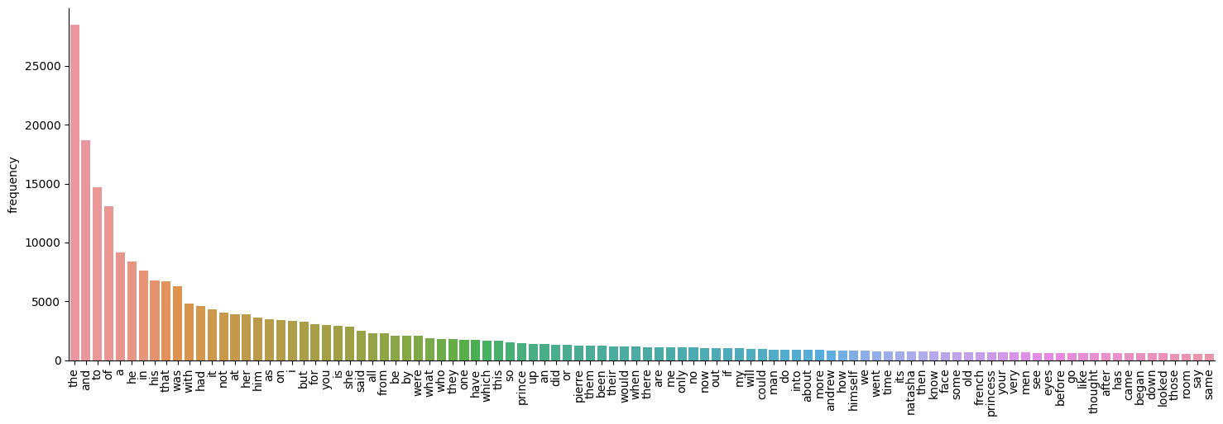
Count distributions
Word frequencies are not uniformly nor normally distributed

Slide 26
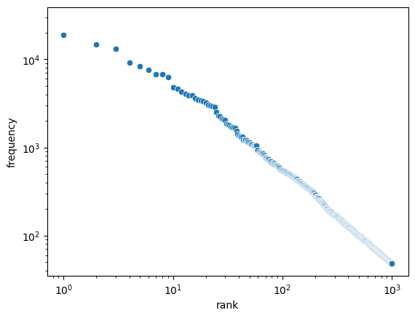
Count distributions
Word frequencies are not uniformly nor normally distributed, but they follow Zipf’s law (frequency is proportional to rank)

Slide 27
Count distributions
Word frequencies are not uniformly nor normally distributed, but they follow Zipf’s law (frequency is proportional to rank)
Values in your matrix will have very different orders of magnitude (for this and other reasons) and some will not be very informative…
Problematic for many applications (think of assumptions on residuals in linear modeling)

Slide 28
Solution: weighting
Can we develop a weighting scheme that somehow normalizes these counts, normalizing for frequency of individual words?
Removing high-frequency words (“stop-words”) is one strategy to avoid some of these issues
Pointwise mutual information (PMI) also counters these issues: sign and magnitude provide information about whether two words occur more/less often than chance
PPMI (positive PMI, i.e., PMI -> 0 if the value is negative) is often used instead (interpretation for negative PMI is tricky…)
Notes:
Remember to resolve for counts! PPMI is zero if PMI is negative… what does it mean to occur less often then chance?

Slide 29
Solution: weighting
Can we develop a weighting scheme that somehow normalizes these counts, normalizing for frequency of individual words?
Removing high-frequency words (“stop-words”) is one strategy to avoid some of these issues
Pointwise mutual information (PMI) also counters these issues: sign and magnitude provide information about whether two words occur more/less often than chance
PPMI (positive PMI, i.e., PMI -> 0 if the value is negative) is often used instead (interpretation for negative PMI is tricky…)
Notes:
As you will see, in many implementations this is what happens!

Slide 30
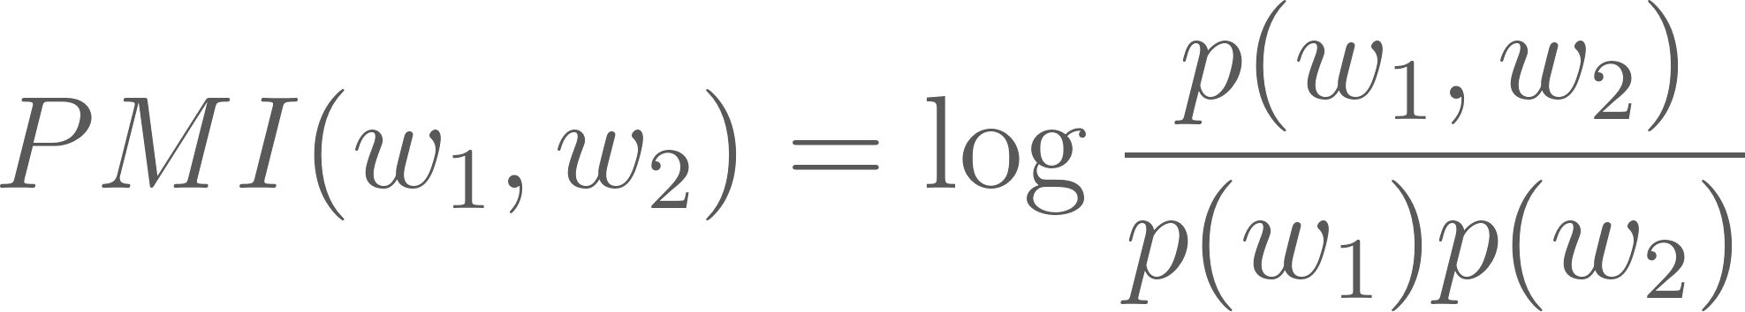
Solution: weighting
Can we develop a weighting scheme that somehow normalizes these counts, normalizing for frequency of individual words?
Removing high-frequency words (“stop-words”) is one strategy to avoid some of these issues
Pointwise mutual information (PMI) also counters these issues: sign and magnitude provide information about whether two words occur more/less often than chance
PPMI (positive PMI, i.e., PMI -> 0 if the value is negative) is often used instead (interpretation for negative PMI is tricky…)
probability of w₁ and w₂ co-occurring
probability of w₁ occurring
probability of w₂ occurring
Notes:
Remember to resolve for counts! PPMI is zero if PMI is negative… what does it mean to occur less often then chance?

Slide 31
Solution: weighting
Can we develop a weighting scheme that somehow normalizes these counts, normalizing for frequency of individual words?
Removing high-frequency words (“stop-words”) is one strategy to avoid some of these issues
Pointwise mutual information (PMI) also counters these issues: sign and magnitude provide information about whether two words occur more/less often than chance
PPMI (positive PMI, i.e., PMI -> 0 if the value is negative) is often used instead (interpretation for negative PMI is tricky…)
probability of w₁ and w₂ co-occurring
probability of w₁ occurring
probability of w₂ occurring
Notes:
Remember to resolve for counts! PPMI is zero if PMI is negative… what does it mean to occur less often then chance?

Slide 32
Normalizing word-document counts
Another commonly used weighting scheme is known as term frequency-inverse document frequency: this transforms raw term-document counts into a matrix that conveys information about how distinctive a term is for a document
… | ML | Food | Sports | Maths
curve | 0 | 1 | 1 | 0
sugar | 0 | 20 | 10 | 0
plot | 35 | 2 | 3 | 30
sphere | 10 | 0 | 15 | 40
foul | 0 | 0 | 0 | 50
the | 352500 | 431230 | 239000 | 748901

Slide 33
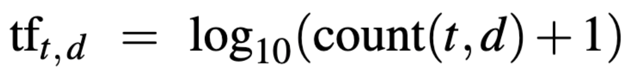
Normalizing word-document counts
Another commonly used weighting scheme is known as term frequency-inverse document frequency: this transforms raw term-document counts into a matrix that conveys information about how distinctive a term is for a document
Compute term-frequency (TF) for each term t and document d with the following formula (though many others exist!)
relative frequency of a word in given document
 | ML | Food | Sports | Maths
curve | 0 | 1 | 1 | 0
sugar | 0 | 20 | 10 | 0
plot | 35 | 2 | 3 | 30
sphere | 10 | 0 | 15 | 40
foul | 0 | 0 | 0 | 50
the | 352500 | 431230 | 239000 | 748901

Slide 34
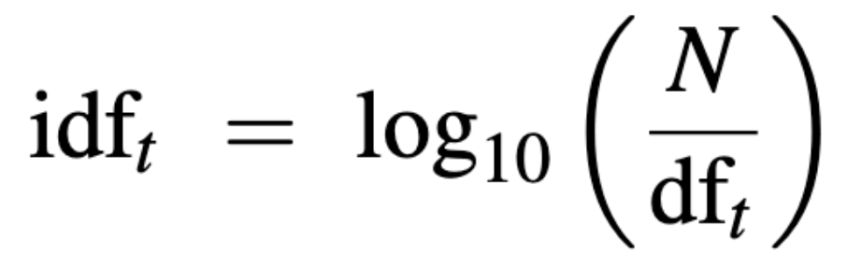
Normalizing word-document counts
Another commonly used weighting scheme is known as term frequency-inverse document frequency: this transforms raw term-document counts into a matrix that conveys information about how distinctive a term is for a document
Compute term-frequency (TF) for each term t and document d with the following formula (though many others exist!)
Compute inverse document frequency (IDF) with the following formula, where N is number of documents, and df_{t} is number of documents containing t
relative frequency of a word in given document
 | ML | Food | Sports | Maths
curve | 0 | 1 | 1 | 0
sugar | 0 | 20 | 10 | 0
plot | 35 | 2 | 3 | 30
sphere | 10 | 0 | 15 | 40
foul | 0 | 0 | 0 | 50
the | 352500 | 431230 | 239000 | 748901
how much information does the word provide (is it common?)

Slide 35
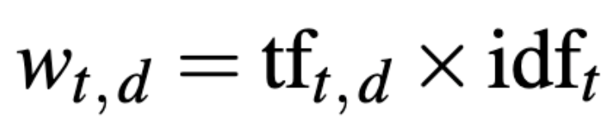
Normalizing word-document counts
Another commonly used weighting scheme is known as term frequency-inverse document frequency: this transforms raw term-document counts into a matrix that conveys information about how distinctive a term is for a document
Compute term-frequency (TF) for each term t and document d with the following formula (though many others exist!)
Compute inverse document frequency (IDF) with the following formula, where N is number of documents, and df_{t} is number of documents containing t
Broadcast and multiply to obtain: TF-IDF score
relative frequency of a word in given document
 | ML | Food | Sports | Maths
curve | 0 | 1 | 1 | 0
sugar | 0 | 20 | 10 | 0
plot | 35 | 2 | 3 | 30
sphere | 10 | 0 | 15 | 40
foul | 0 | 0 | 0 | 50
the | 352500 | 431230 | 239000 | 748901
high e.g., if TF is high (many occurrences in a document) and IDF high (not frequent across documents)
how much information does the word provide (is it a frequent in all corpora?)

Slide 36
Sparsity
Co-occurrence matrices are going to be very, very sparse
Huge dimensionality with little information content
Not good for storage and efficiency…
But also a problem for meaning!
… which brings us back to the one-hot encoding issue
these words look less similar than they actually are, just because of random features of the corpus
 | sleep | night | highway | bed | park | rest
hotel | 10 | 9 | 1 | 0 | 5 | 0
motel | 0 | 4 | 7 | 0 | 5 | 5
Notes:
Comment on rest and sleep

Slide 37
Sparsity
Co-occurrence matrices are going to be very, very sparse
Huge dimensionality with little information content
Not good for storage and efficiency…
But also a problem for meaning!
… which brings us back to the one-hot encoding issue
these words look less similar than they actually are, just because of random features of the corpus
 | sleep | night | highway | bed | park | rest
hotel | 10 | 9 | 1 | 0 | 5 | 0
motel | 0 | 4 | 7 | 0 | 5 | 5
can we leverage “latent” structure in the dimensions (e.g., sleep and rest are related, and this is encoded in their vectors)?
Notes:
Comment on rest and sleep

Slide 38
Singular value decomposition
Singular value decomposition (SVD) is a common method used to find a lower-dimensional approximation of a given matrix. C can be decomposed into the product of three matrices.
The product is the best rank k approximation of X in terms of least squares:
C
(w x c)
U
(w x k)
S
(k x k)
x
V
(k x c)
x
=
diagonal
matrix
orthogonal to U
count matrix
“reduced” vector matrix with orthonormal rows
New word representations (word embedding matrix) which preserve similarity relations from the original matrix
trading some direct interpretability for efficiency
Notes:
S accounts for the magnitude transformation

Slide 39
A few hacks might be needed
SVD does not always work well on raw counts!
A few hacks may be required for it to work well, including:
using log frequencies
setting min/max bound for frequency
computing correlations instead of counts
using small windows
Rohde et al., 2005: An Improved Model of Semantic Similarity Based on Lexical Co-Occurrence
Notes:
S accounts for the magnitude transformation – matrix you can recompute from U, S, V is the best rank k approximation to X, in terms of least squares

Slide 40
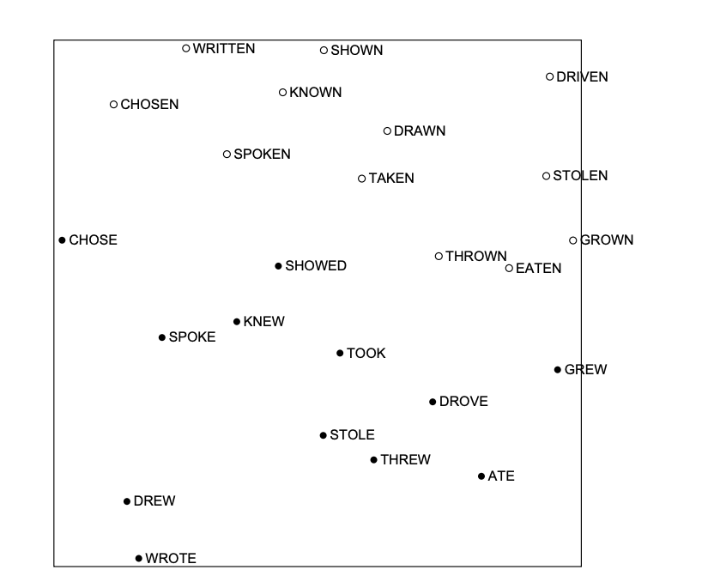
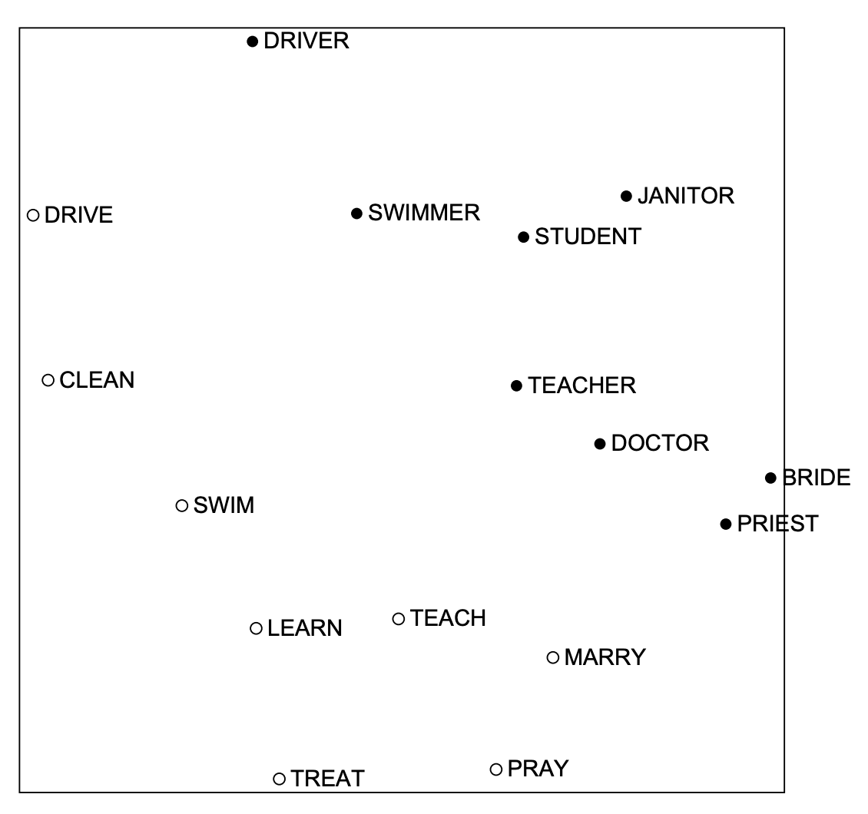
Emergent properties of SVD scaling
Notes:
Interpretability is regained! From bare similarity to… interesting emergent properties! We will see more about that later and next week.

Slide 41
break

Slide 42
interim summary
Representations based on counts have two main disadvantages
Counts can have very different order of magnitudes, and some words may not be particularly useful due to their very high frequency in all text (e.g., the, a, is)
Normalization / scaling techniques (e.g., PMI and TF-IDF scaling) can solve some of these issues
Dimensionality can be prohibitively high, leading to storage and computational issues, and sparsity in the resulting representations
Dimensionality reduction techniques (such as SVD) can help!
Vectors resulting exhibit some interesting regularities, e.g., vector directionality can encode information about semantic and syntactic relations

Slide 43
questions?

Slide 44
Meet vector spaces!
dog
.
.
.
leaf
tree
.
cat
.
house
.
castle
A beautiful property of this way of thinking about words is that it has a spatial interpretation
Vectors correspond to coordinates (and directional information) in a multidimensional space
Vectorial and metric relations between vectors should reflect similarity in meaning
Notes:
A bit implicit in what we have been saying so far (e.g., in talking about “most similar”) – for example, what does most similar mean?

Slide 45
Similarity metrics: Euclidean Distance
y_{tree}
dog
.
.
.
leaf
tree
y_{dog}
.
cat
.
house
.
castle
x_{tree}
x_{dog}
words with similar meaning are closer in vector space
can be extended to high-dimensional spaces

Slide 46
A trickier example
dog
.
30
20
.
cat
10
.
house
10
20
30
 | good | run
cat | 12 | 10
dog | 30 | 25
house | 30 | 10
in some cases, e.g., when vectors tend to have different norms, Euclidean distance may not be a great metric
Cosine similarity leverages information about the angle between vectors

Slide 47
Cosine similarity
dog
.
30
20
.
cat
10
.
house
10
20
30
Using trigonometry, we can calculate the cosine of the angle, which has some interesting properties
cos(0) = 1
cos(90) = 0
cos(180) = -1
… it is higher, the less you need to “move” the vectors to overlay them onto each other
similarity = cos(θ)
distance = 1 - cos(θ)
Notes:
Periodicity at 180 degrees… note that angles can always be reduced to angles between 0 and 180!

Slide 48
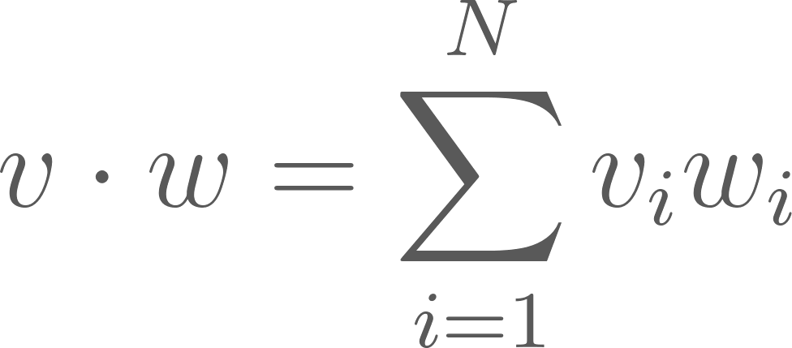
Cosine similarity
dog
.
30
20
.
cat
10
.
house
10
20
30
Cosine similarity is closely related to the dot product between two vectors
It is higher when two vectors have large values in the same dimension

Slide 49
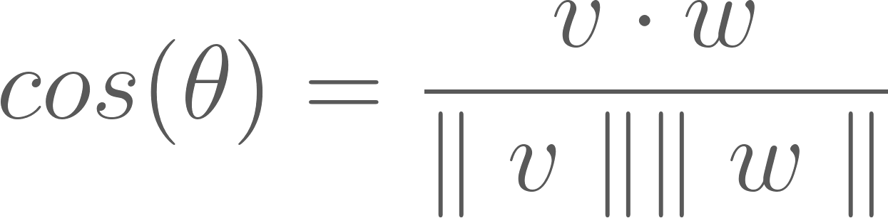
Cosine similarity
dog
.
30
20
.
cat
10
.
house
10
20
30
The cosine of an angle between two vectors is the normalized dot product between the two vectors:

Slide 50
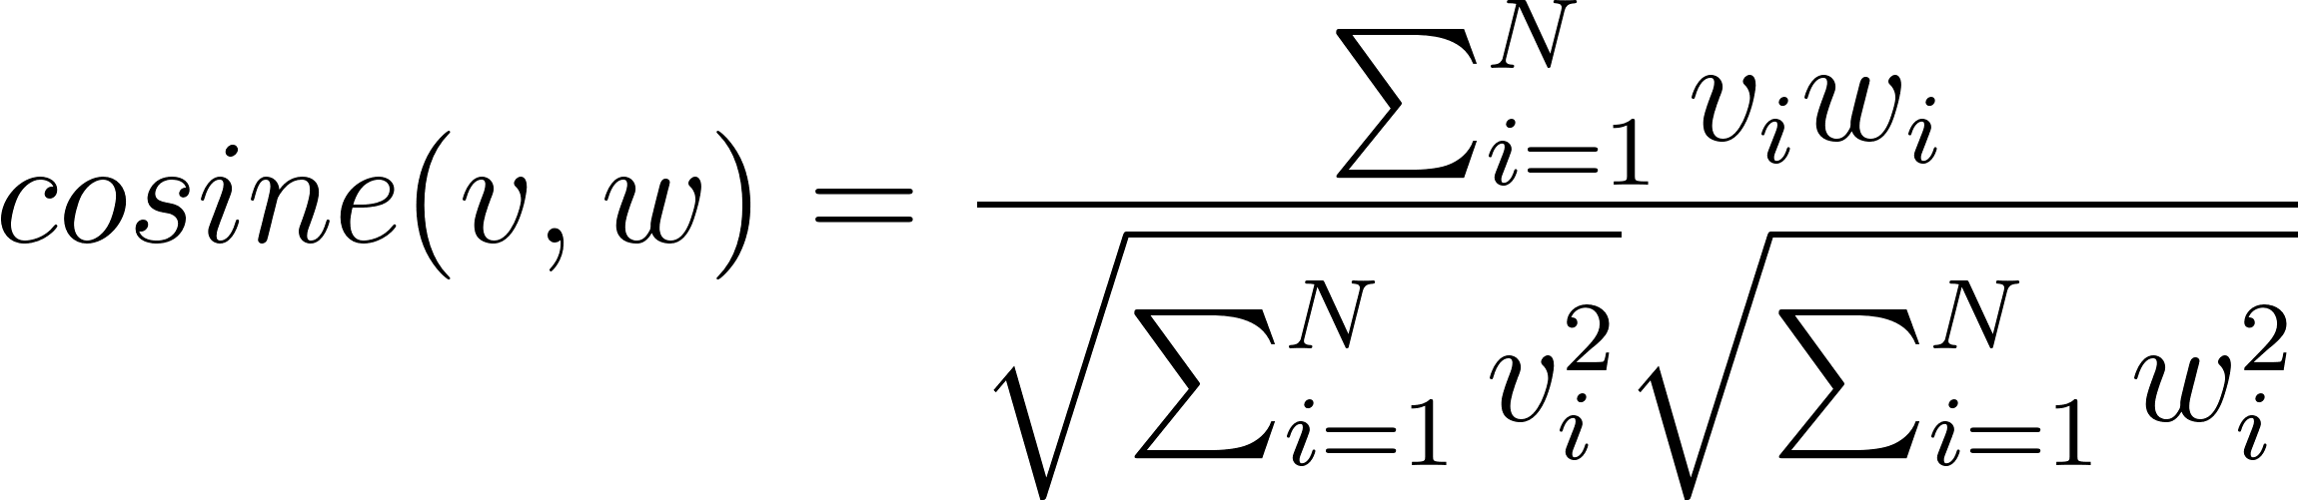
Cosine similarity
dog
.
30
20
.
cat
10
.
house
10
20
30
The cosine of an angle between two vectors is the normalized dot product between the two vectors:
Notes:
Specify what v and w are

Slide 51
questions?

Slide 52
interim summary
Multidimensional representations of word (or document) meaning have a spatial interpretation: they are vectors in a multidimensional space
Algebraic operations can be applied to extract relations (e.g., similarity)
Euclidean distance and cosine similarity are two ways to quantify distance/similarity between word vectors

Slide 53
How do I know if resulting vectors are good?
Aka, how do I evaluate models?
Intrinsic evaluation:
Specific/intermediate subtask (not related to “applications”)
Fast to compute
Helps to understand the system
Not practically useful, unless it has a relation to a “real-world” task
Extrinsic evaluation:
Evaluates on a real task (e.g., named entity recognition – aka, is this word an entity?)
Often needs to add some modules
Downsides: if performance is bad, whose fault is that…?
Often defines “state of the art”

Slide 54
Semantic relatedness
word 1 | word 2 | human
tiger | cat | 7.5
tiger | tiger | 10
book | paper | 7.4
computer | internet | 5.4
plane | car | 6.2
professor | doctor | 7.2
stock | phone | 1.3
Humans rate the semantic similarity of pairs of words
Cosine similarity is computed between the corresponding vectors
Correlations between the two are computed
The higher the correlation, the better the model
Existing datasets: e.g., WordSim353

Slide 55
Synonym detection
A reference word is provided, together with possible synonyms
Cosine similarity between reference and candidates is computed
The word with highest similarity is chosen as predicted synonym
Check whether this matches the true synonym
Compute the proportion of examples where the model gets it right
example
apple
instance
statue
photograph

Slide 56
Semantic analogy
?
man : woman = king : ?
Do vectors preserve these semantic (and syntactic) relations (which are trivial for humans) in algebraic relations between the resulting vectors?
king
woman
man
Notes:
good:best rough:
better:best rougher:
year:years law:
city:city’s bank:
see:saw return:

Slide 57
Semantic analogy
Simple algebra between word vectors
?
king
woman
man
Notes:
synonym detection; concept categorisation (clustering); semantic relatedness (correlation with human ratings); analogy (introduced by Mikolov, and on which count-based models tend to fail)

Slide 58

Semantic analogy
Simple algebra between word vectors
Find word in dictionary whose vector has smallest cosine distance from the output of this
Evaluate word vectors by how often the closest match is the target word
Enforcing a number of semantic and syntactic regularities which reflect human language processing
?
king
woman
man
Notes:
There may not be a word there!

Slide 59
questions?

Slide 60
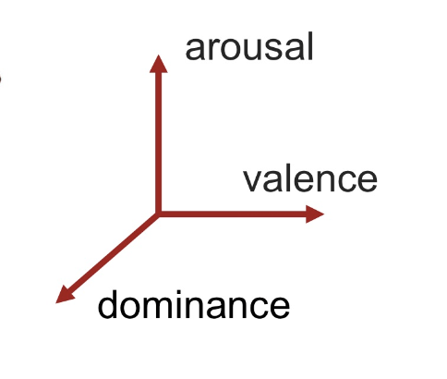
Note: “interpretable” vector representations
We will not focus on them in this course, but there are other ways to build vector representations of text with a spatial interpretation
A common way is using lexical norms, coming from human ratings of words on a given dimension
E.g., emotions and many cognitive and psycholinguistic variables (check out, for example, https://www.reilly-coglab.com/data)
Advantages: interpretability, and ability to capture complex dimensions
Disadvantages: disagreement, incompleteness, few languages, etc
A more modern way to do these kind of annotations is through zero-shot inference, try playing with: https://huggingface.co/MoritzLaurer/mDeBERTa-v3-base-mnli-xnli
https://saifmohammad.com/WebPages/nrc-vad.html
Notes:
ones we saw before)

Slide 61
any relation to human meaning representations?
Statistical learning paradigms
Evaluation tasks are informed by things we deem “human”
Prediction as a foundational property of human cognition (next week!)

Slide 62
tomorrow :)
Introducing spaCy
Experimenting with word vectors
Building document vectors
A simple sentiment classifier

